Slide 1

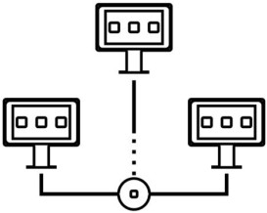



Introduction to
Parallel and Distributed Programming
CS6
Multi-core Programming - PThreads
Sachin D N
Notes:
saloni@wilp.bits-pilani.ac.in , Saloni Bhartia

Slide 2
Agenda
Lab 3
Problems programming shared memory systems.
Controlling access to a critical section.
Thread synchronisation.
Programming with POSIX threads.
Mutexes.
Producer-consumer synchronisation and semaphores.
Barriers and condition variables.
Read-write locks.
Thread safety.

Slide 3
Lab 3
Enhance performance using multithreading within one node
Use multithreading to improve Lab 2 code on slave nodes. Idea is to improve performance using multiple cores on the same node and show synchronization problems/solutions.

Slide 4


Lab 2: Use cluster to distribute work and do some
parallel data processing
Now that you have a group of nodes managed as a cluster
Create a distributed data processing capability.
Master node takes a dataset and distributes / partitions the data on multiple active slaves that have
enough resources.
Slaves process the data and send results back to Master. Master merges / reduces the data and reports back to the user.
Use blocking vs non-blocking messages in OpenMPI.
Status of the work at slaves is reported back to the master as work progresses and finishes.
Master collects the performance data (CPU, mem, IO) and stores it for analysis.
Any errors are also reported to the master.
Use compression to transfer data. Quantify communication cost - bytes sent over the network,
latency of transfer.
Use OpenMPI for communication between nodes, zlib etc. compression libs
Handle a node crash - Master should get work done on remaining nodes. What are the options - should it restart the job or only shift part of the work to another node ? How is a slave crash detected
? Use the heartbeat mechanism.

Slide 5
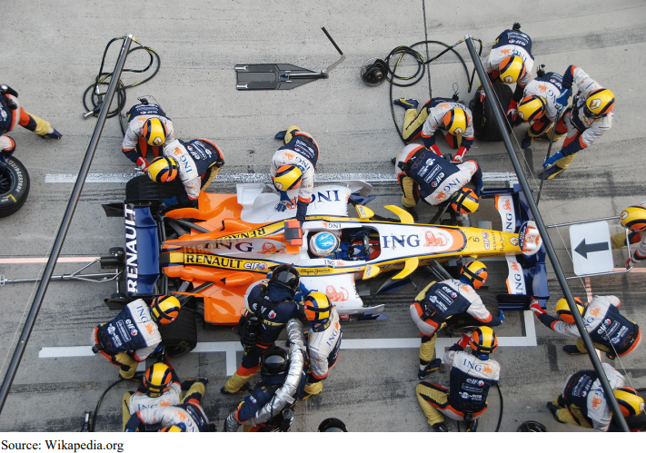
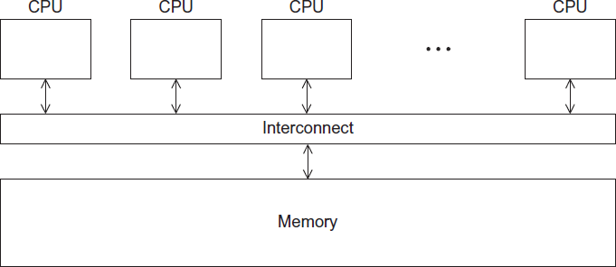

Slide 6
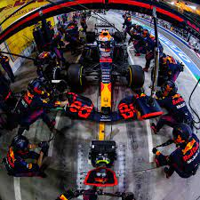

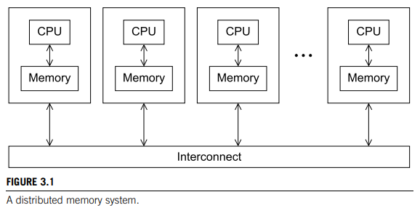
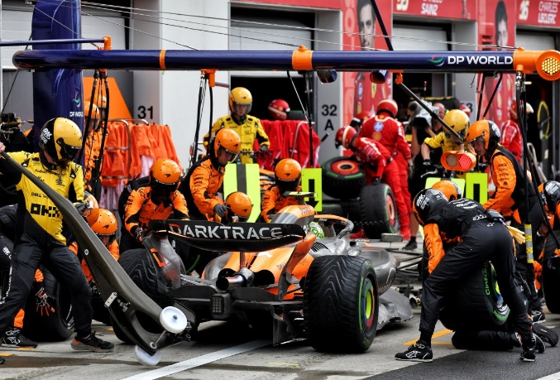
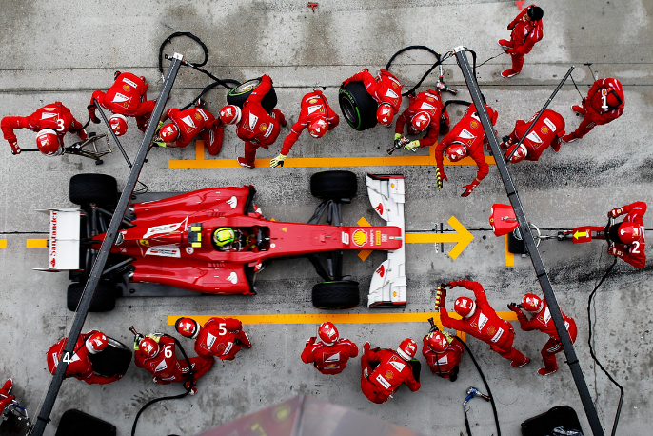

Slide 7
Our Goal and Where we are
Distributed data processing
Parallel and distributed
Programming
Computing
Processing
System

Slide 8
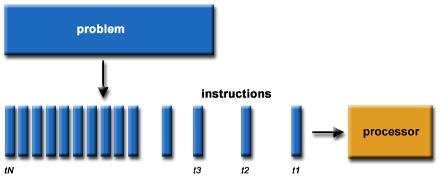

Serial versus Parallel Programming
Notes:
https://researchcomputing.princeton.edu/support/knowledge-base/parallel-code

Slide 9
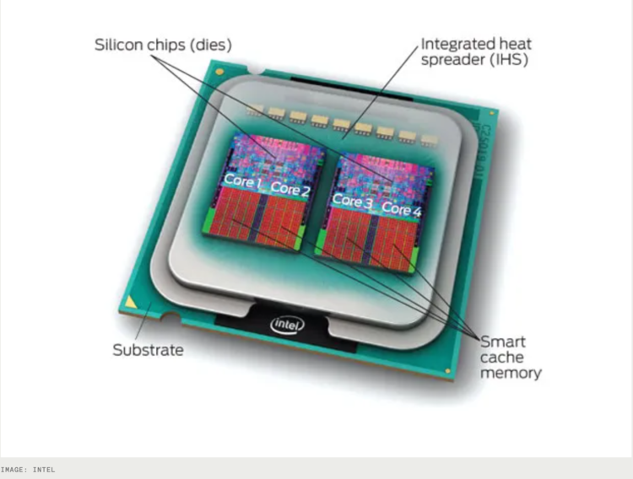
CPU-core – A microprocessing unit on a CPU-chip. Each CPU-core can execute an independent set of instructions from the computer.
GPU – GPU stands for the Graphics Processing Unit. Originally intended to process graphics, in the context of parallel programming this unit can do a large number of simple arithmetic computations.
Memory – In this guide memory refers to Random-Access Memory, or RAM. The RAM unit stores the data that the CPU is actively working on.

Slide 10
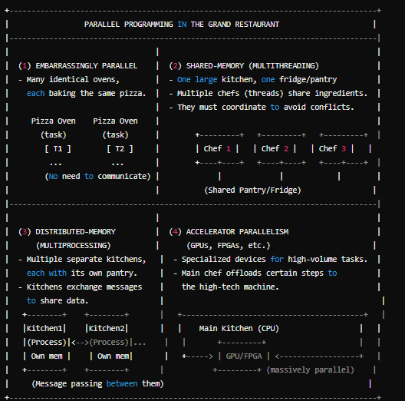


Slide 11

A Shared Memory System

Slide 12
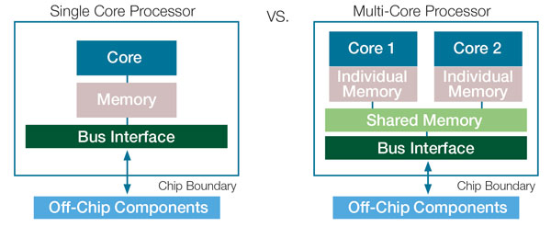
Multicore processors
Multicore processors are a type of central processing unit (CPU) that integrates two or more individual processor cores onto a single chip. Each core in a multicore processor operates independently and can execute its own set of instructions. Multicore processors have become ubiquitous in modern computing devices, ranging from desktop computers to smartphones and embedded systems. Here's an overview of multicore processors:
Key Characteristics:
Multiple Cores:
Multicore processors have two or more individual processor cores on a single chip. Common configurations include dual-core (2 cores), quad-core (4 cores), and octa-core (8 cores), but more cores are also available in high-end processors.
Parallel Processing:
Each core in a multicore processor can execute instructions independently. This allows for parallel processing of tasks, resulting in improved performance and multitasking capabilities.
Shared Resources:
Multicore processors typically share certain resources among the cores, such as the memory subsystem, cache, and input/output interfaces. Efficient management of shared resources is crucial for optimal performance.
Thread Execution:
Multicore processors can execute multiple threads simultaneously. A thread is a sequence of instructions that represents a task or process. Multithreading enables efficient utilization of multiple cores for concurrent execution of threads.

Slide 13
Multicore processors
Advantages:
Improved Performance:
Multicore processors can significantly enhance the performance of computing devices by allowing for parallel execution of tasks. This is particularly beneficial for tasks that can be divided into parallel threads, such as multimedia processing and scientific simulations.
Multitasking:
Multicore processors excel at multitasking. They can handle multiple applications and processes simultaneously without significant performance degradation.
Energy Efficiency:
In many cases, multicore processors can offer better energy efficiency compared to single-core processors. By distributing the workload across multiple cores, each core can operate at lower clock speeds and voltage levels, reducing power consumption.
Scalability:
Multicore processors can be scaled by increasing the number of cores on a chip. This scalability allows manufacturers to meet the performance demands of a wide range of applications and devices.
Challenges:
Parallel Programming:
Taking full advantage of multicore processors requires software that is designed for parallel execution. Parallel programming can be complex, and not all applications can easily be parallelized.
Resource Sharing:
Efficiently managing shared resources like memory and cache among multiple cores can be challenging to ensure optimal performance.
Heat Dissipation:
High-core-count processors can generate a significant amount of heat. Effective cooling solutions are required to maintain thermal stability.
Software Compatibility:
Older software or applications that are not optimized for multicore processors may not fully benefit from the additional cores.

Slide 14
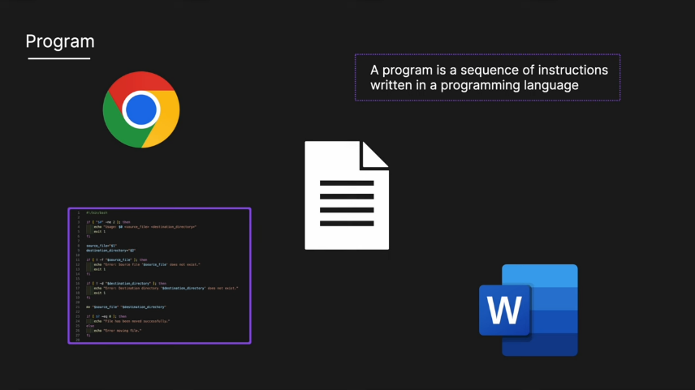
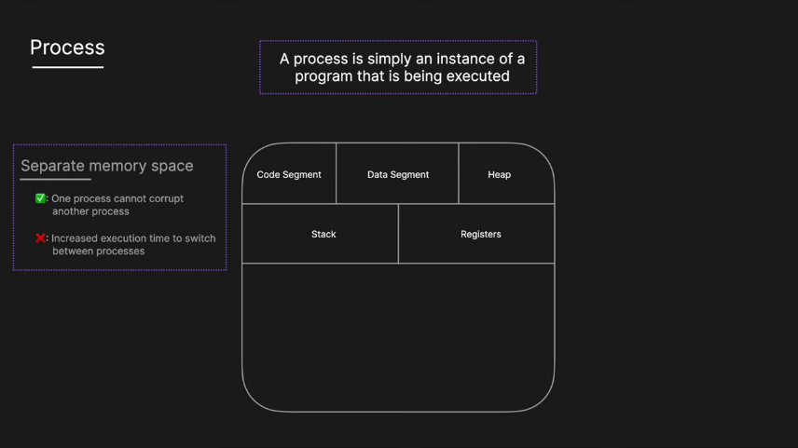
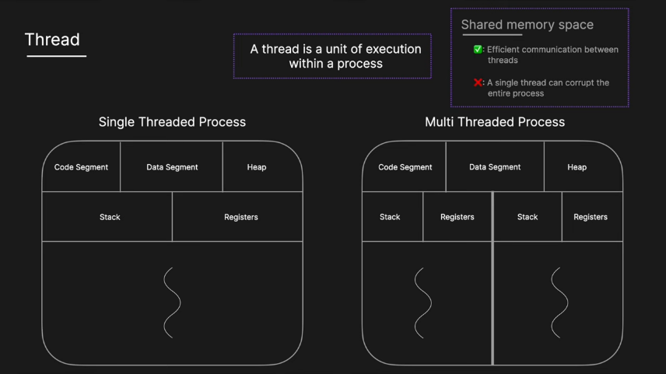
Processes and Threads
A process is an instance of a running (or suspended) program.
Threads are analogous to a “light-weight” process.
In a shared memory program a single process may have multiple threads of control.

Slide 15
POSIX®Threads
Also known as Pthreads.
A standard for Unix-like operating systems.
A library that can be linked with C programs.
Specifies an application programming interface (API) for multi-threaded programming.
The Pthreads API is only available on POSIXR systems — Linux, MacOS X, Solaris, HPUX, …

Slide 16
Why Use Pthreads? (High-Level Motivation)
A thread is like a mini-program running inside a larger program. Instead of running multiple completely separate processes, you can have one program that spawns multiple threads, each doing part of the overall work. Because threads share the same memory space, they can communicate and share data more efficiently than separate processes (which typically must use message passing).
Real-World Example #1 – Web Server:
When a web server receives multiple requests (say from different users), it can spawn a new thread for each incoming request. Each thread then processes the request in parallel, sharing some global information like configuration settings or cached data.
This can be more efficient than starting a whole new process for each request, because processes don’t share memory automatically—they need extra overhead for communication.
Real-World Example #2 – Image Processing:
If you have a large image and want to apply a filter (e.g., a blur or edge detection) in parallel, you can split the image into segments. Each thread processes a segment in memory. Because the threads share the entire image buffer as global data, it’s easy for them to coordinate boundaries between segments without complicated data transfers.
Key Advantages
Shared Data: Threads can see each other’s variables if those variables are declared globally.
Lightweight: Spawning threads is often faster than starting full processes.
Concurrency: Multiple tasks run “simultaneously,” allowing you to take advantage of modern multicore CPUs.

Slide 17
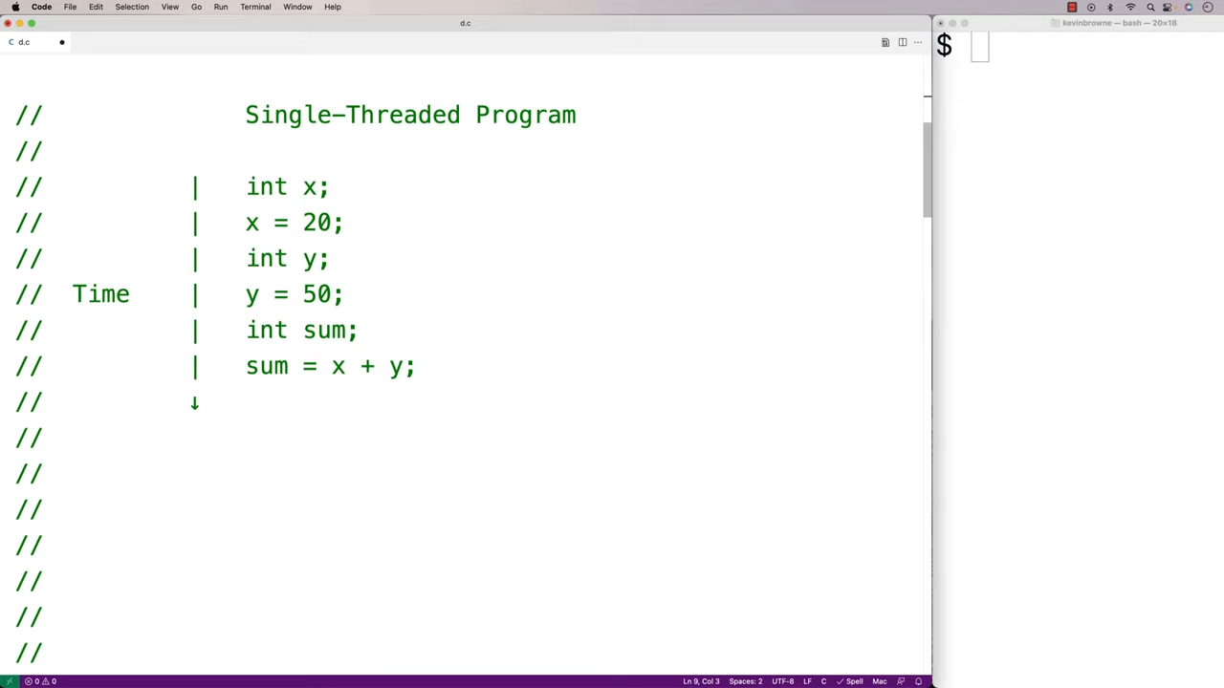
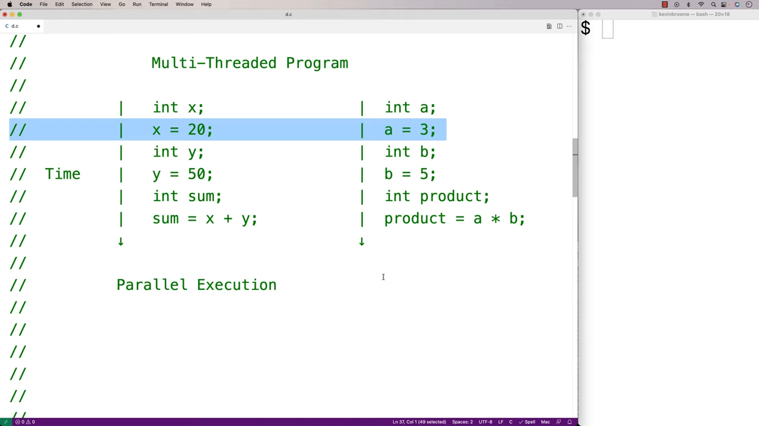
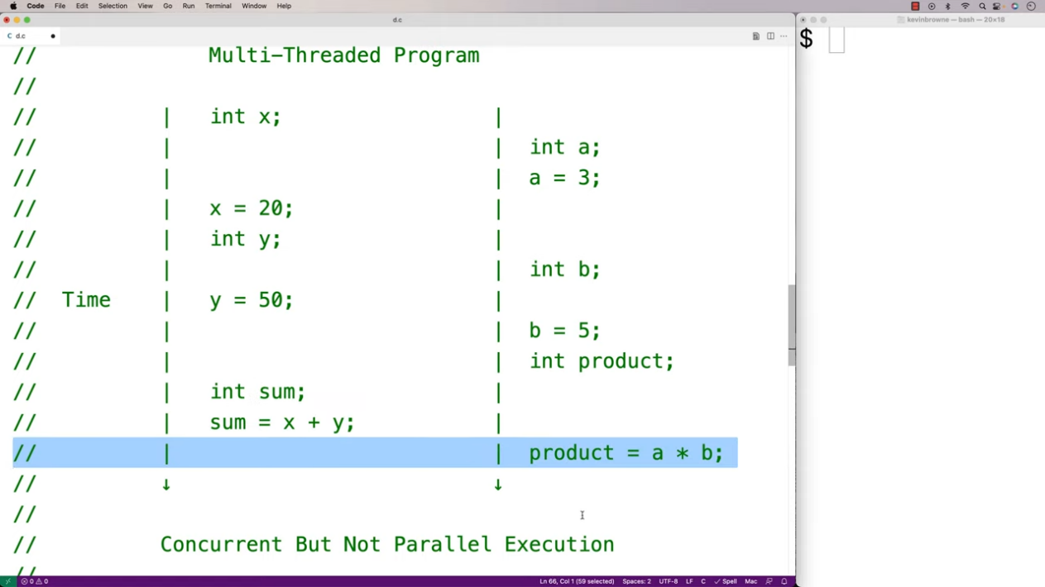
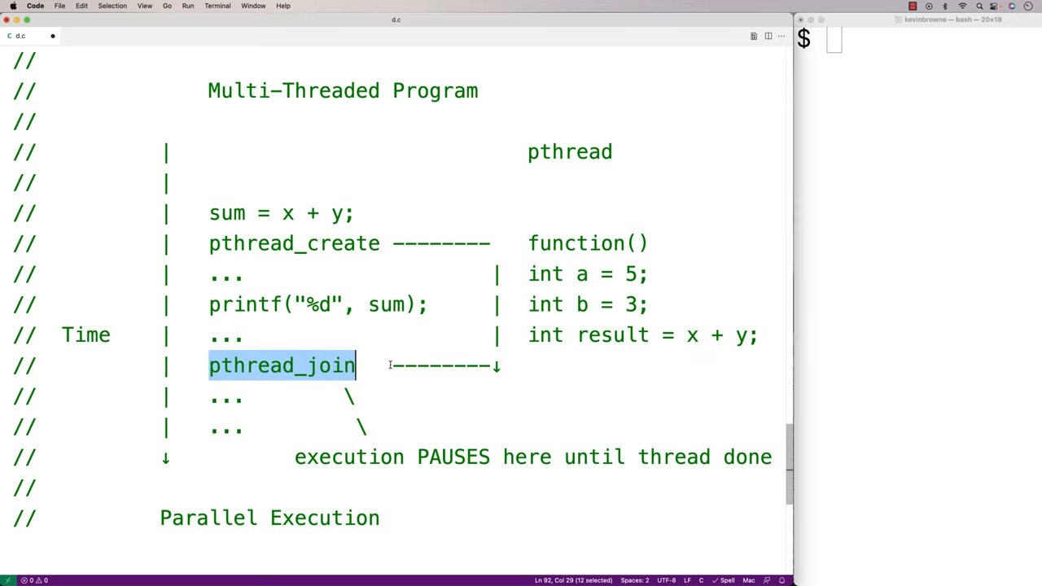

Slide 18
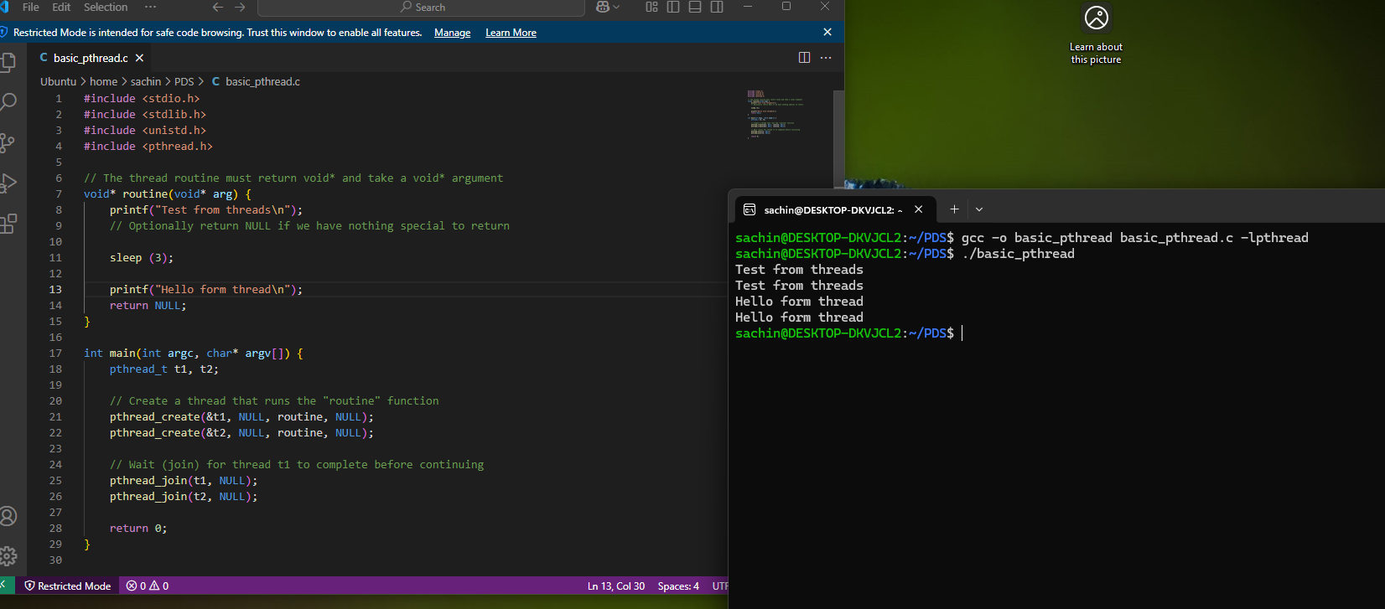

Slide 19
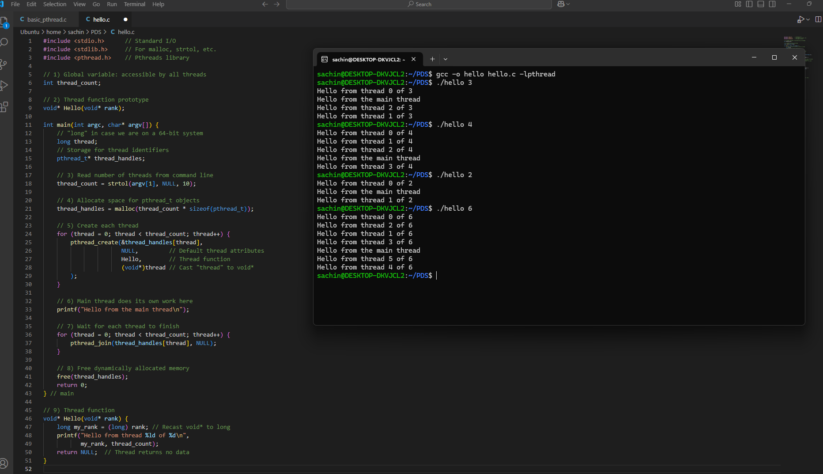
Hello World!

Slide 20
Compiling a Pthread program
gcc -o main main.c -lpthread
./main
link in the Pthreads library

Slide 21
Running a Pthreads program
. / pth_hello <number of threads>
. / pth_hello 1
Hello from the main thread Hello from thread 0 of 1
. / pth_hello 4
Hello from the main thread Hello from thread 0 of 4
Hello from thread 1 of 4
Hello from thread 2 of 4
Hello from thread 3 of 4

Slide 22
Starting the Threads
Processes in MPI are usually started by a script.
In Pthreads the threads are started by the program executable.

Slide 23

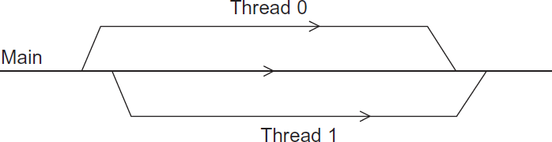



Running the Threads
Main thread forks and joins two threads.

Slide 24
Stopping the Threads
We call the function pthread_join once for each thread.
A single call to pthread_join will wait for the thread associated with the pthread_t object to complete.

Slide 25
Real-World Use Cases
Server Handling Multiple Connections
Scenario: A server application that processes user requests in parallel.
How it works with Pthreads:
The main thread waits for a connection.
Upon receiving a connection (say from a web browser), the main thread creates a new thread to handle all communication with that client.
The newly created thread can access global server configuration (like file paths or database credentials) and process the client’s request.
Once done, the thread either returns or goes into a “thread pool” of reusable threads.
Numerical Simulations / Data Analysis
Scenario: You have a large dataset and a mathematical simulation that needs to iterate over each data point.
Example: Climate modeling, where each thread processes a portion of a 2D or 3D grid (temperature, pressure, etc.).
How it works with Pthreads:
Global variables might store the entire simulation grid.
Each thread is assigned a subset of the grid (e.g., rows 100–199).
They all run the same function, but use their “rank” to figure out which part of the data to process.

Slide 26
Real-World Use Cases
4.3 Real-Time Video Processing
Scenario: A security system analyzing video frames for anomalies (like motion detection).
How it works with Pthreads:
A main capture loop obtains new video frames.
Each new frame spawns a thread that processes it (detecting edges, shapes, or movement).
Several frames might be processed in parallel if the camera feed is fast.
The threads share certain global settings (e.g., detection thresholds, region-of-interest masks).
4.4 UI Applications / Games
Scenario: A graphical application (like a game) where one thread handles rendering while another handles AI logic or user input.
How it works with Pthreads:
The rendering thread continuously updates the screen.
Another thread reads user inputs (mouse, keyboard) and updates global state.
Yet another thread might handle the game physics.
All these threads share data structures but must synchronize to avoid conflicts.

Slide 27
Thread Lifecycle & Design Patterns
Fork-Join Approach
Used in the example program:
Fork (spawn): Main thread creates a batch of worker threads.
Join (wait): Main thread blocks until each worker finishes, then the program ends.
This approach is common for short, fixed-size tasks—like a known number of tasks to be completed in one shot.
“Thread Pool” / “Workers on Demand”
For servers or applications with indefinite workload, you might not want to create and destroy threads repeatedly. Instead:
Pre-create a pool of threads.
Each incoming task (e.g., request or job) is assigned to an available (idle) thread from the pool.
When the thread finishes, it signals it’s ready for the next task.
This pattern helps reduce overhead caused by constantly creating and destroying threads.
On-the-Fly Thread Creation
The “Web server” style approach: The main thread continuously runs, and each time a request arrives, it spins up a new thread if needed

Slide 28
Potential Pitfalls & Best Practices
Shared Data Conflicts (Race Conditions)
Since all threads in Pthreads share global variables, two threads may try to modify the same variable simultaneously, causing unpredictable results (a “race condition”).
Solution: Use synchronization constructs (mutexes, semaphores, condition variables) to lock shared data while one thread updates it.
Zombie Threads
If we create threads but never call pthread_join or pthread_detach, you waste system resources. The thread is done executing but is still occupying an internal structure in the OS.
Always join or detach your threads when they are finished.
Too Many Threads
Creating thousands of threads can lead to overhead or resource exhaustion. You usually want fewer threads than or around the same magnitude as the number of CPU cores, especially for CPU-bound tasks.
Global Variables vs. Local Variables
Overuse of global variables can cause debugging nightmares.
Try to give threads local copies of data or pass them references to specific areas of memory they need to update.
Memory Management
If you dynamically allocate structures for each thread (like in malloc), ensure you free them after you’re done. This is especially important in long-running applications.

Slide 29
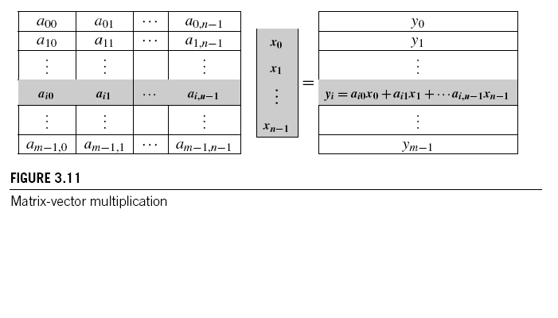



Matrix-Vector Multiplication in pthreads

Slide 30
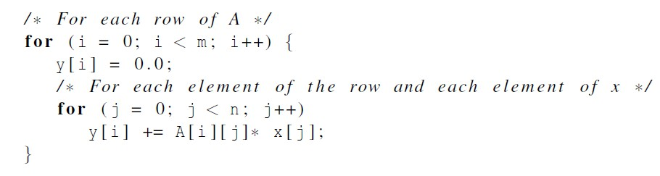

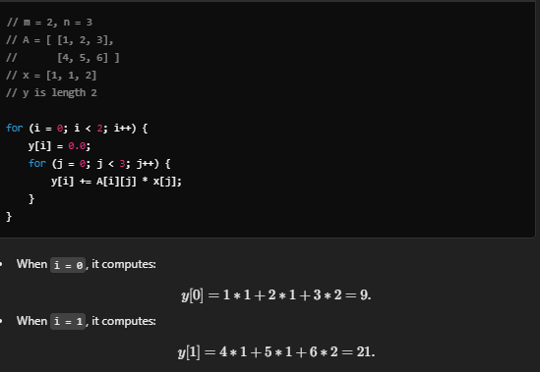
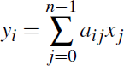
Serial pseudo-code

Slide 31
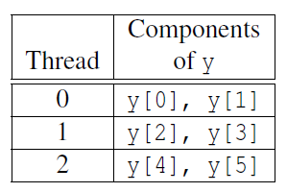
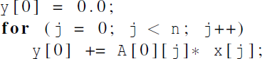
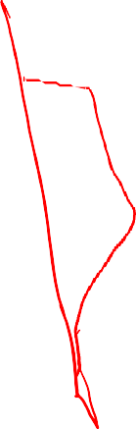
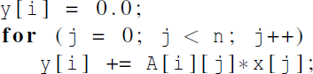
Using 3 Pthreads
thread 0
general case

Slide 32
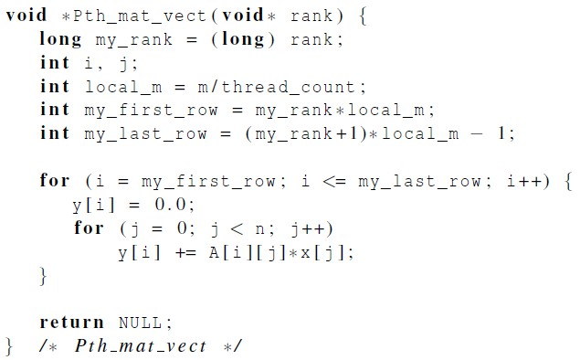




Pthreads matrix-vector multiplication

Slide 33
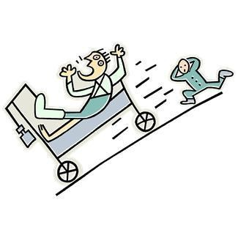
Critical sections
A critical section is a piece of code that accesses and modifies shared data. If multiple threads can execute that code at the same time, the data might become inconsistent or produce unpredictable results—a scenario called a race condition.
Race Condition Example: Two threads both want to update a shared variable. If Thread A reads the variable and then Thread B reads the variable (before A’s update is stored), one thread’s update may overwrite the other’s. Hence the final value depends on the timing, not just the logic.
Key Point
We must ensure that only one thread at a time can execute the critical section that modifies (or sometimes even reads) a shared resource if consistency is at risk. This is usually done with synchronization mechanisms like mutexes (mutual exclusion locks).

Slide 34

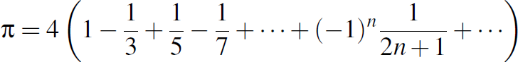
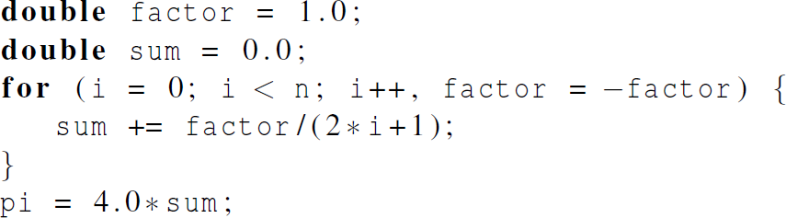

Estimating π

Slide 35
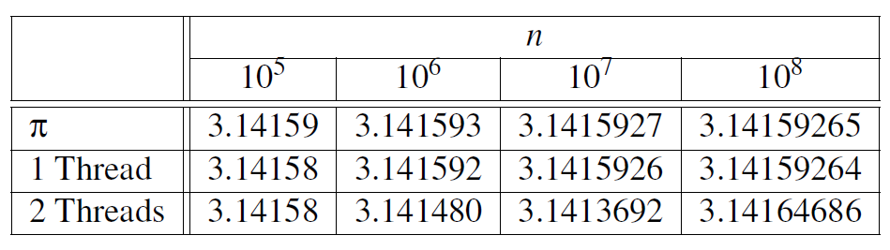
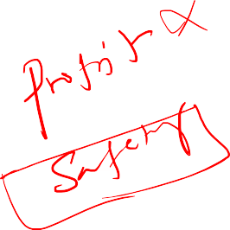
Using a dual core processor
Note that as we increase n, the estimate with one thread gets better and better.

Slide 36
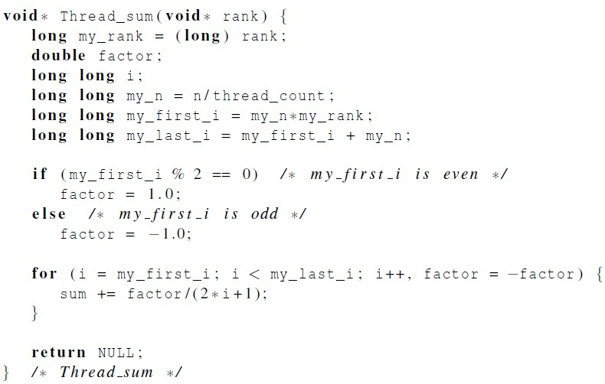



A thread function for computing π

Slide 37
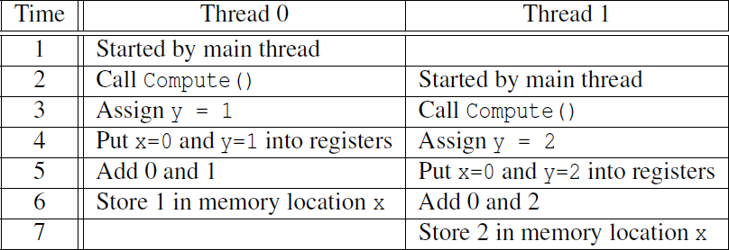




Possible race condition

Slide 38




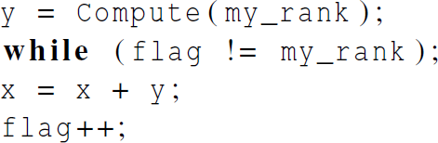
Busy-Waiting
A thread repeatedly tests a condition, but, effectively, does no useful work until the condition has the appropriate value.
Beware of optimizing compilers, though!
flag initialized to 0 by main thread

Slide 39
Pthreads global sum with busy-waiting
Initialization: y = Compute(my_rank);
Each thread computes its own value of y based on its rank (thread ID).
Busy-Wait Loop: while (flag != my_rank);
This line ensures that a thread will only proceed if the flag variable matches its rank.
If the condition is not met, the thread keeps checking the condition in a loop without doing any other work. This is the busy-waiting part.
Critical Section: x = x + y;
Once the thread passes the busy-wait loop, it enters the critical section and performs the operation x = x + y;.
Update Flag: flag++;
After the critical section is executed, the thread increments the flag so that the next thread can enter the critical section.

Slide 40
Busy-Wait Loop in Action
Suppose the main thread initializes flag to 0.
If thread 1 completes its computation (y = Compute(my_rank);) before thread 0, it will encounter the while loop and keep checking while (flag != my_rank); until flag becomes 1.
Thread 0, on the other hand, will pass the while loop because flag is initially 0, and it proceeds to the critical section x = x + y;.
After thread 0 finishes its critical section, it increments flag++ (so now flag becomes 1), allowing thread 1 to proceed.

Slide 41
Key Points – Busy Waiting
Busy-Waiting: While thread 1 waits for flag to become 1, it constantly checks the condition, using CPU resources inefficiently.
Compiler Optimization: The busy-wait solution assumes that statements are executed as written. If compiler optimizations are enabled, the order of statements might change, leading to incorrect results.
Performance: Busy-waiting, also known as a spinlock, can degrade performance, especially if one thread is delayed or preempted by the operating system.
Busy-waiting ensures exclusive access to critical sections, but it's not an ideal solution due to its inefficiency and potential for performance degradation. There are better synchronization mechanisms, such as mutexes and semaphores, that avoid busy-waiting and provide more efficient ways to manage access to shared resources.

Slide 42
CS6

Slide 43
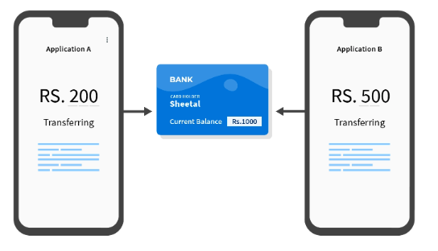
Mutexes
A thread that is busy-waiting may continually use the CPU accomplishing nothing.
Mutex (mutual exclusion) is a special type of variable that can be used to
restrict access to a critical section to a single thread at a time.

Slide 44
Example: Bank
Scenario: Two threads (one deposits $50, another withdraws $30) share a balance.
Problem: If both threads read and write balance at the same time (no lock), the final outcome might be wrong (e.g., $70 or $150 instead of $120). This is a race condition.
Real-Time Analogy:
Imagine two bank tellers updating your account at the same moment. One teller sees $100, adds $50 (should be $150).
Meanwhile, the other teller also sees $100, subtracts $30 (should be $70).
Whichever teller writes last overwrites the other’s transaction.
Solution (Mutex):
A mutex acts like a single “teller window”—only one thread can update balance at a time.
Each thread locks the shared resource, does the deposit or withdrawal, then unlocks for the next thread.
This guarantees a correct final balance of $120 every time.

Slide 45

Mutexes
Used to guarantee that one thread “excludes” all other threads while it executes the critical section.
The Pthreads standard includes a special type for mutexes:
pthread_mutex_t.

Slide 46
Mutexes
When a Pthreads program finishes using a mutex, it should call
In order to gain access to a critical section a thread calls

Slide 47
Mutexes
When a thread is finished executing the code in a critical section, it should call

Slide 48
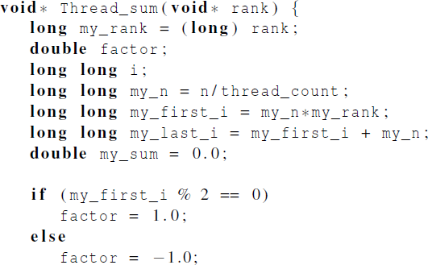
Global sum function that uses a mutex (1)

Slide 49
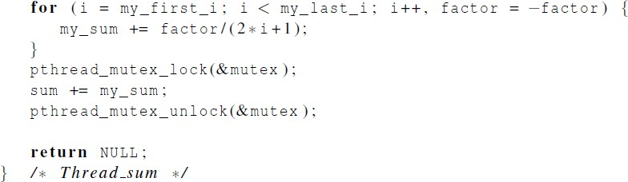
Global sum function that uses a mutex (2)

Slide 50
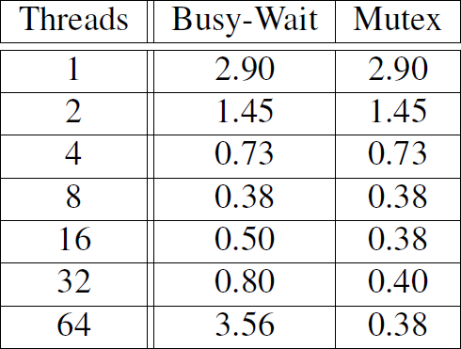
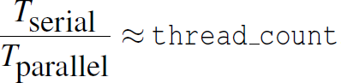
Run-times (in seconds) of π programs using n = 108 terms on a system with two four-core processors.

Slide 51
Why Mutexes Help with More Threads
No Spinning: Threads that cannot enter the critical section do not keep checking a condition repeatedly. They are put to sleep by the OS and thus do not burn CPU cycles.
Better Scaling: If you have more threads than CPU cores, the OS can schedule different threads or tasks on available cores, rather than letting threads spin.
Cleaner Semantics: It’s easy to see where the critical section begins and ends (mutex_lock/mutex_unlock).

Slide 52
Performance Insights
With a small number of threads (less than or equal to the number of cores), busy-waiting might not seem too bad. The waiting thread might get scheduled on a free core and not hamper performance significantly.
With many threads, mutexes avoid the chaos of many threads spinning.
Lock Contention: Even with mutexes, if lots of threads try to enter the same critical section frequently, you can still have slowdowns—but it’s still better than busy-waiting in most cases.

Slide 53
Key Takeaways
Mutexes ensure only one thread can access the critical section at a time.
Lock the mutex to “enter” the critical section, unlock it to “leave.”
Busy-waiting wastes CPU cycles by checking in a loop; mutexes let the system schedule other threads when a thread can’t enter the critical section immediately.
Scaling beyond the number of CPU cores is much more efficient with mutexes, which avoid performance collapse due to spinning.

Slide 54

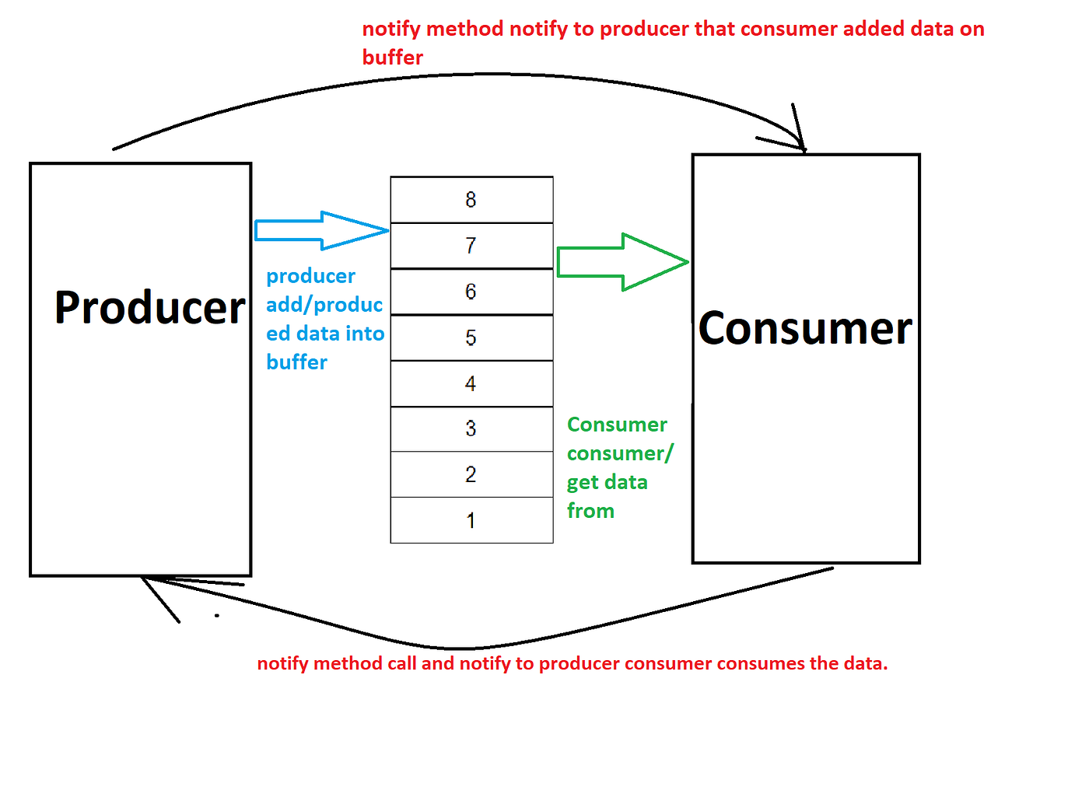
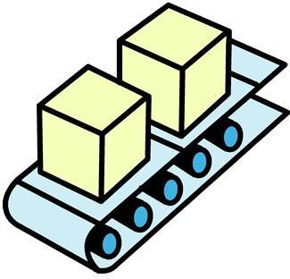

Producer-Consumer Synchronization and Semaphores

Slide 55
The Producer-Consumer Problem
1. The Producer-Consumer Problem
We have a finite buffer of size NNN.
A Producer thread creates items and places them into the buffer.
A Consumer thread removes items from the buffer and processes them.
Key Constraints:
The producer should not add items if the buffer is full.
The consumer should not remove items if the buffer is empty.
Only one thread at a time should modify the buffer (to avoid race conditions on shared data structures).

Slide 56
Why a Single Mutex Isn’t Enough
A mutex (mutual exclusion) only solves the problem of concurrent access to shared data. It ensures that when one thread is modifying the buffer, no other thread can do so simultaneously.
However, it does not prevent the producer from writing into a full buffer, nor does it stop the consumer from reading an empty buffer. A mutex alone has no concept of “capacity” or “items available.”
Thus, merely locking/unlocking a mutex around buffer operations will prevent corruption but can still lead to:
Producer Overruns: Attempting to place an item into an already-full buffer.
Consumer Underruns: Attempting to remove an item from an empty buffer.

Slide 57
How Semaphores Solve This
Semaphores are synchronization primitives that count how many resources (or “permits”) are available. In the producer-consumer context, we typically use two semaphores:
empty
Tracks the number of empty slots in the buffer.
Initialized to NNN (the size of the buffer).
The producer must wait (sem_wait(&empty)) if empty is 0 (meaning the buffer is full). After producing an item, the producer signals (sem_post(&full)) one more slot is full.
full
Tracks the number of filled slots in the buffer.
Initialized to 0 (nothing in the buffer at the start).
The consumer must wait (sem_wait(&full)) if full is 0 (meaning the buffer is empty). After consuming an item, the consumer signals (sem_post(&empty)) one more slot is empty.
Additionally, we still need a mutex (or binary semaphore) to ensure that only one thread modifies the buffer at a time—even if it’s not empty or full. Semaphores alone count availability, but do not enforce mutual exclusion on the shared data structure.

Slide 58
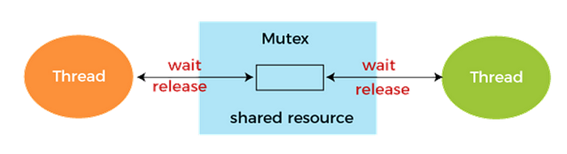
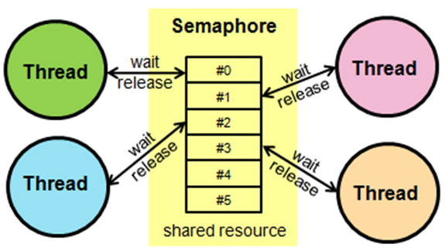

Slide 59
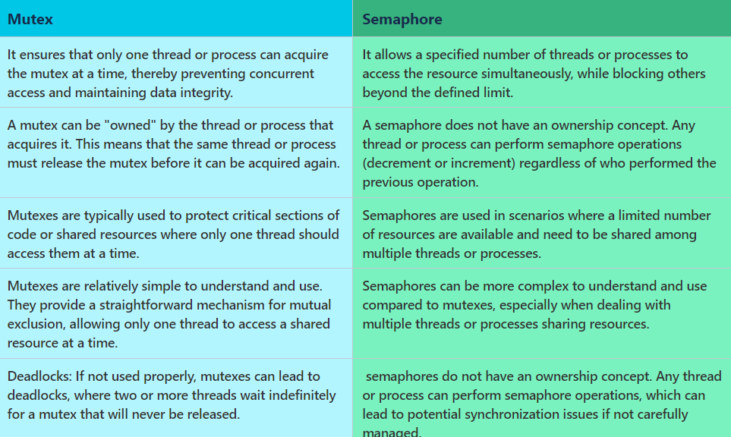

Slide 60
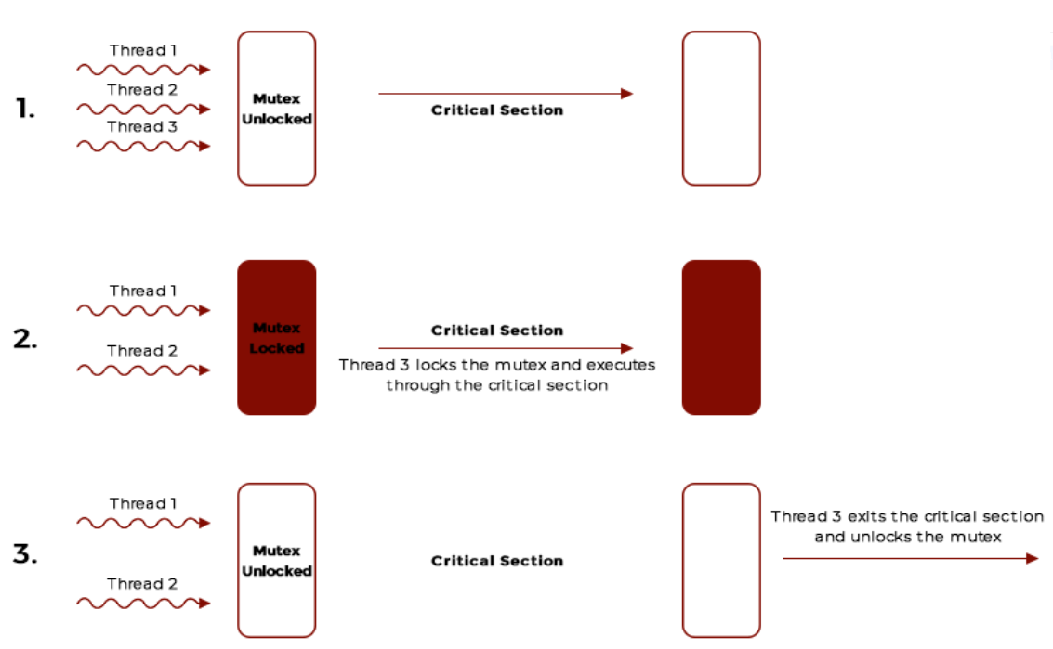

Slide 61
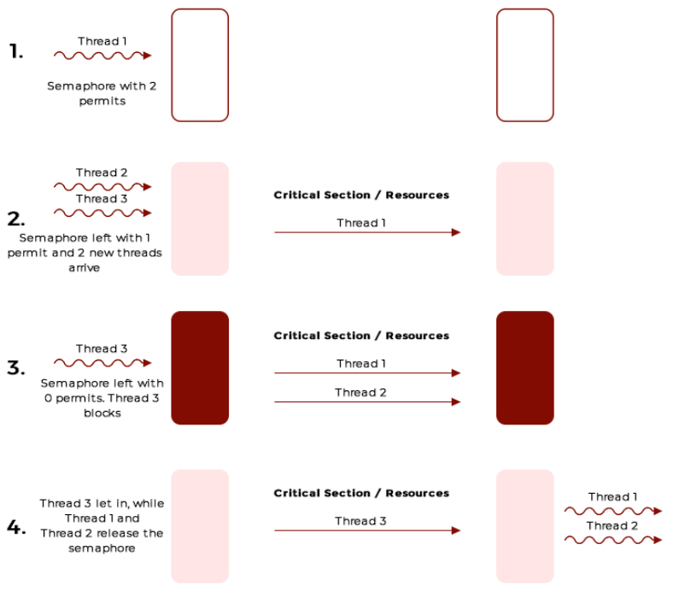

Slide 62


Typical Producer-Consumer Flow (Bounded Buffer)

Slide 63


Real-Time Analogy

Slide 64
Mutex = solves race conditions by ensuring one thread at a time can modify shared data.
Semaphores = manage resource availability (empty slots, full slots) in a counting fashion.
In Producer-Consumer, both are necessary: semaphores to handle empty/full constraints and a mutex to handle safe access to the buffer itself.

Slide 65

Barriers and Condition Variables

Slide 66


Barriers
A barrier is a synchronization mechanism that ensures all threads must reach a certain checkpoint (the “barrier”) before any of them can proceed.
Once a thread arrives, it waits until every other participating thread arrives.
When the final thread arrives, all threads are released simultaneously to continue execution.

Slide 67

Using barriers to time the slowest thread

Slide 68


Using barriers for debugging

Slide 69
Busy-waiting and a Mutex
Implementing a barrier using busy-waiting and a mutex is straightforward.
We use a shared counter protected by the mutex.
When the counter indicates that every thread has entered the critical section, threads can leave the critical section.

Slide 70

Busy-waiting and a Mutex
We need one counter variable for each instance of the barrier, otherwise problems
are likely to occur.

Slide 71

Implementing a barrier with semaphores

Slide 72

Meeting Room Check‐In:
Each person (thread) enters the lobby and signs their name on a list (increments arrived).
If you’re not the last to arrive, you wait.
The final person sees the list is full, announces “everyone’s here!” (posts the semaphore multiple times).
Everyone leaves the lobby together to start the meeting (the barrier).

Slide 73
Condition Variables
A condition variable lets threads wait for a particular condition to become true, then be signaled once that condition changes. Condition variables are always used in conjunction with a mutex to avoid race conditions while checking/updating the shared state.
Typical Flow
A thread locks a mutex and checks some condition (e.g., “is the buffer empty?”).
If the condition is not met, it calls pthread_cond_wait, which atomically unlocks the mutex and puts the thread to sleep.
Another thread, after changing that condition (e.g., adding an item to the buffer), calls pthread_cond_signal (or pthread_cond_broadcast), which wakes one or more waiting threads.
The awakened thread re-locks the mutex and re-checks the condition, then proceeds if it is now true.

Slide 74

Condition Variables

Slide 75

Implementing a condition variables

Slide 76


Slide 77
Key Differences
Mutex: Simple lock protecting shared data from concurrent write.
Semaphore: More flexible; can track counts of resources or be used as a binary lock.
Barrier: All threads rendezvous at specific checkpoint(s).
Condition Variable: Threads can sleep on certain conditions and get signaled when it’s time to wake up.

Slide 78
Real-World Summaries
Mutex = One person at a time can access the vault.
Semaphore = We have k identical resources. Each time a person enters, we decrement the semaphore. If it’s zero, new entrants must wait.
Barrier = Everyone meets at the designated spot before proceeding as a group.
Condition Variable = “Wait in the lobby until your table is ready; we’ll signal you when it’s free.”

Slide 79
Takeaway
Each synchronization primitive has a specific role.
Barriers help ensure all threads have completed a phase.
Condition variables allow threads to efficiently wait for a specific state to become true.
Mutexes and semaphores handle mutually exclusive access and resource counting.
Used together, these tools make concurrency safer and more structured.

Slide 80


Read-Write Locks

Slide 81
Controlling access to a large, shared data structure
Read-Write Lock:
Readers acquire the lock in read mode. Multiple readers can lock simultaneously.
Writers acquire the lock in write mode, which excludes both other writers and any readers.
Linked List: We have a simple singly linked list. Threads may want to read from it (traverse or print elements) or write to it (insert/remove).

Slide 82




Linked Lists

Slide 83

Basic Linked List Operations
insert at the front (a “write” operation) and print the entire list (a “read” operation).
pthread_rwlock_wrlock(&rwlock); ensures exclusive access for writing.
pthread_rwlock_rdlock(&rwlock); allows shared access for readers, as long as no one else has it locked for writing.

Slide 84

Thread Functions
Writer Thread: inserts random values periodically.
Reader Thread: prints the list periodically.

Slide 85



Slide 86

Library:
Many people can browse books (read) at the same time.
But when the librarian needs to reorganize books on the shelf (write), they temporarily close access so no one else can read while they rearrange.
rwlock: This is your “library” lock that can be shared among multiple readers or held exclusively by a single writer.

Slide 87
When to Use Read-Write Locks
Use Case: When you have a data structure with frequent reads and infrequent writes, so that multiple readers can safely proceed in parallel, reducing contention.
Downside: If writes are frequent or if read operations are short but you have many of them, overhead from acquiring a read-write lock can outweigh its benefits. Also, in some implementations, a continuous stream of readers can starve a waiting writer (or vice versa) unless carefully managed (some rwlock implementations provide writer preference or reader preference modes).

Slide 88
Takeaway
pthread_rwlock_t provides a straightforward way for multiple threads to read data concurrently while blocking when a single thread needs to write.
This can greatly improve performance in read-heavy workloads compared to a simple mutex that forces all readers to serialize.
However, we must assess our application’s read/write patterns to decide if an rwlock is truly beneficial.

Slide 89

Linked List Performance
100,000 ops/thread
99.9% Member
0.05% Insert
0.05% Delete

Slide 90

Linked List Performance
100,000 ops/thread
80% Member
10% Insert
10% Delete

Slide 91
Caches, Cache-Coherence, and False Sharing
Recall that chip designers have added blocks of relatively fast memory to processors called cache memory.
The use of cache memory can have a huge impact on shared-memory.
A write-miss occurs when a core tries to update a variable that’s not in cache, and it has to access main memory.

Slide 92

Pthreads matrix-vector multiplication

Slide 93

Run-times and efficiencies of matrix-vector multiplication
(times are in seconds)

Slide 94

Thread-Safety

Slide 95

What Is Thread Safety?
Definition: A piece of code (function, method, library) is considered thread-safe if it functions correctly when accessed by multiple threads concurrently.
Goal: Thread-safe code ensures that shared data is not corrupted or left in an inconsistent state due to overlapping threads’ reads/writes.

Slide 96
Why It Matters
Concurrency: Modern applications often use multiple threads to improve performance or responsiveness.
Data Integrity: Without proper synchronization, simultaneous reads/writes can lead to race conditions, data corruption, crashes, or unpredictable results.
Scalability: Well-designed thread-safe components can be reused in larger, multi-threaded systems with fewer modifications.

Slide 97
Common Thread-Safety Pitfalls
Race Conditions: When two or more threads access shared data without adequate synchronization, the final outcome depends on the non-deterministic timing of the threads.
Deadlocks: When threads hold locks and wait on each other in a cycle (e.g., Thread A holds Lock 1 waiting on Lock 2, while Thread B holds Lock 2 waiting on Lock 1).
Starvation: A thread never acquires the resource it needs to proceed, due to scheduling or prioritization issues (e.g., writer starvation in a read-write lock).
Improper Use of Atomic Operations: Single operations (e.g., incrementing a shared counter) may seem safe but can still introduce hidden race conditions if they aren’t the only action needed.

Slide 98
Core Mechanisms for Thread Safety
Mutexes (Mutual Exclusion Locks)
Ensure only one thread at a time can execute a critical section (e.g., updating shared data).
Straightforward, but can reduce concurrency if many operations need the same lock.
Semaphores
Count-based or binary synchronization primitives.
Often used for producer-consumer problems, limiting resource usage, or building higher-level constructs (like barriers).
Read-Write Locks
Allow multiple concurrent readers but only one writer at a time.
Good if your workload is read-heavy.
Condition Variables
Let threads sleep until a specific condition becomes true, preventing busy waiting.
Often used when a thread must wait for a state change (e.g., “buffer not empty” or “work queue not full”).
Barriers
Ensure threads wait until all have reached a checkpoint before any proceed.
Useful when computation proceeds in discrete phases.

Slide 99
Best Practices
Minimize Shared State
The fewer global or shared variables, the fewer opportunities for races.
Use thread-local storage or pass data by value where possible.
Keep Critical Sections Short
Holding a lock for too long can degrade performance and risk deadlocks.
Release locks as soon as the shared data modifications are complete.
Use High-Level Abstractions
Wherever possible, rely on standard libraries or well-tested concurrency primitives (e.g., pthread_*, C++ <thread>, or concurrency frameworks).
These reduce the chance of subtle bugs
4. Test Under Load
Concurrency bugs often appear only under stress or unusual timing.
Use tools like thread sanitizers and stress testing to detect race conditions, deadlocks, or data races.

Slide 100
Real-World Analogy
Multiple Bank Tellers (Mutexes)
Only one teller can update an account at a time to avoid messing up the balance.
Library Reading Room (Read-Write Lock)
Multiple people can read books concurrently, but if someone wants to reorganize the shelves (write), everyone must pause their reading first.
Restaurant Waitlist (Condition Variables)
Customers (threads) wait until the hostess signals that a table is free (the “condition”). They don’t stand in the doorway blocking others (no busy waiting).

Slide 101
Thread safety is about ensuring correctness when multiple threads operate in parallel. It goes beyond just “locking data”: it requires choosing appropriate synchronization primitives (mutexes, semaphores, condition variables, etc.) and applying them consistently. By systematically preventing race conditions, deadlocks, and other concurrency hazards, you can scale your applications’ performance while maintaining data integrity.

Slide 102
Concluding Remarks (1)
A thread in shared-memory programming is analogous to a process in distributed memory programming.
However, a thread is often lighter-weight than a full-fledged process.
In Pthreads programs, all the threads have access to global variables, while local variables usually are private to the thread running the function.

Slide 103
Concluding Remarks (2)
When indeterminacy results from multiple threads attempting to access a shared resource such as a shared variable or a shared file, at least one of the accesses is an update, and the accesses can result in an error, we have a race condition.

Slide 104
Concluding Remarks (3)
A critical section is a block of code that updates a shared resource that can only be updated by one thread at a time.
So the execution of code in a critical section should, effectively, be executed as serial code.

Slide 105
Concluding Remarks (4)
Busy-waiting can be used to avoid conflicting access to critical sections with a flag variable and a while-loop with an empty body.
It can be very wasteful of CPU cycles.
It can also be unreliable if compiler optimization is turned on.

Slide 106
Concluding Remarks (5)
A mutex can be used to avoid conflicting access to critical sections as well.
Think of it as a lock on a critical section, since mutexes arrange for mutually exclusive access to a critical section.

Slide 107
Concluding Remarks (6)
A semaphore is the third way to avoid conflicting access to critical sections.
It is an unsigned int together with two operations: sem_wait and sem_post.
Semaphores are more powerful than mutexes since they can be initialized to any nonnegative value.
A semaphore is a variable used to control access to a shared resource within the operating system, and a mutex is simply a lock acquired before entering a critical section and releasing it. A semaphore is better for multiple instances of a resource, but a mutex is better for a single shared resource

Slide 108
Concluding Remarks (7)
A barrier is a point in a program at which the threads block until all of the threads have reached it.
A read-write lock is used when it’s safe for multiple threads to simultaneously read a data structure, but if a thread needs to modify or write to the data structure, then only that thread can access the data structure during the modification.

Slide 109
Concluding Remarks (8)
Some C functions cache data between calls by declaring variables to be static, causing errors when multiple threads call the function.
This type of function is not thread-safe.

